Slide 1


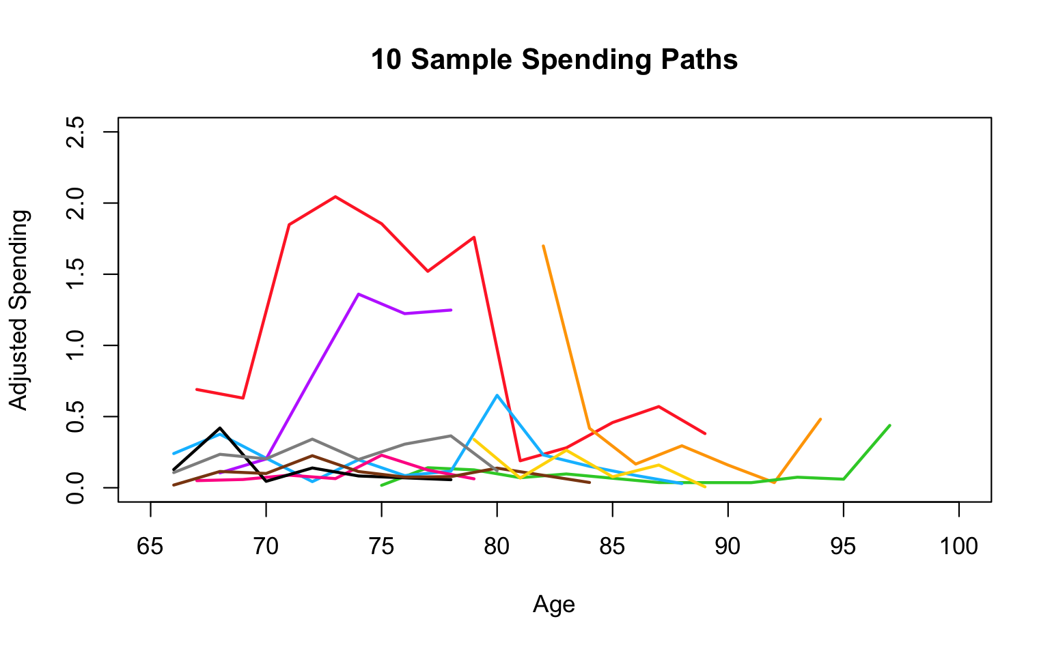
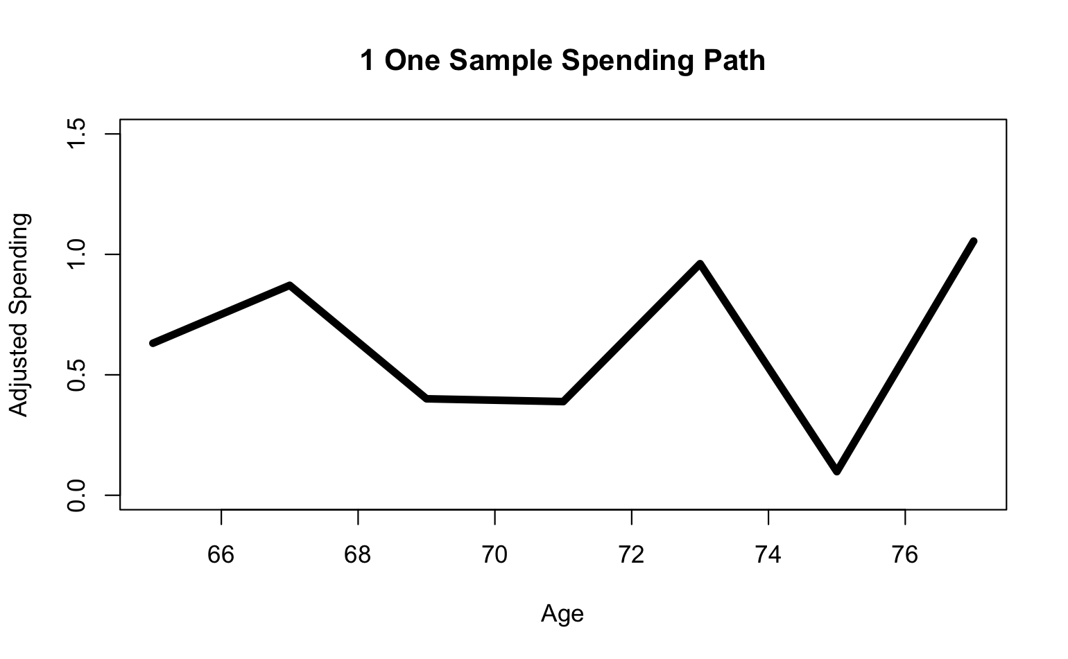

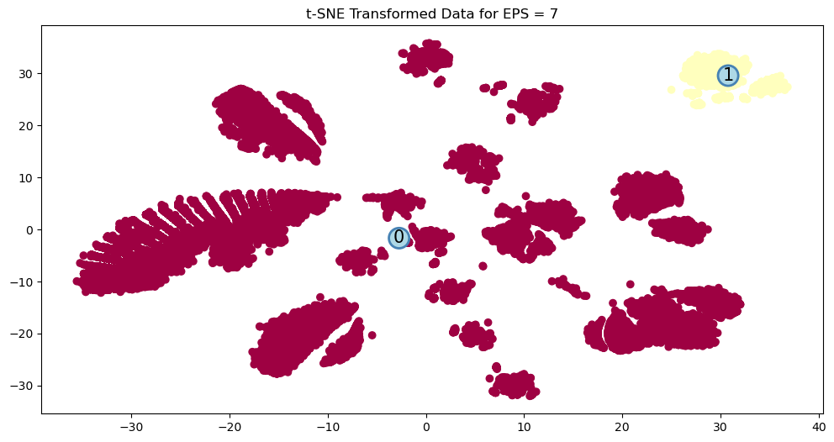
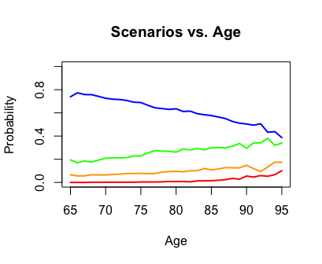
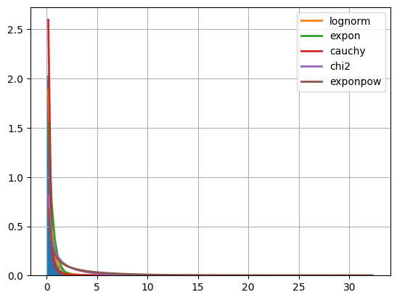
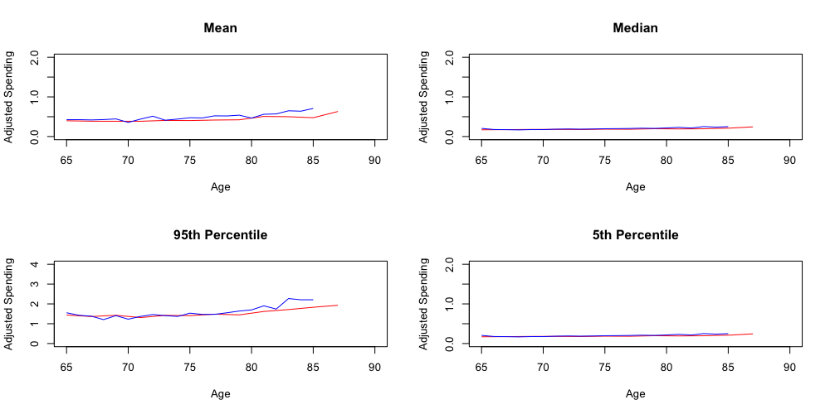
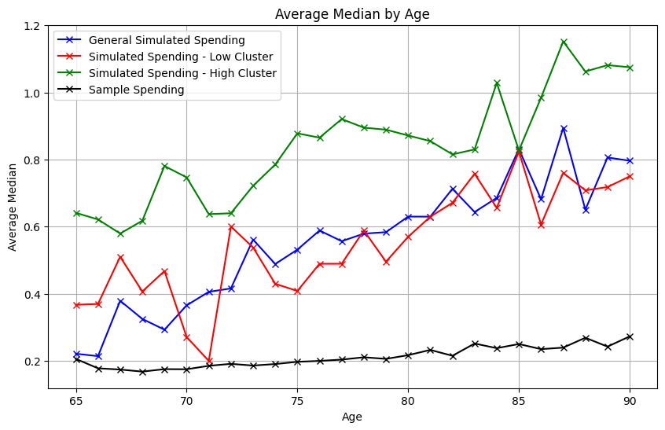
Modeling Retiree’s Liquidity Needs - Sponsored by T. Rowe Price
Jessica Rizzo, Yihang Hu, Haotian Xiang, Mingtao Jia, and Haoyang Wang
Advised by Dr. David Ruppert (Cornell University), Sudipto Banerjee, (T. Rowe) and Dr. Louisa Schafer (T. Rowe)
INTRODUCTION
GOAL
CONCLUSIONS
The T. Rowe Price Group is an asset management firm. We are collaborating with the Lifecycle Research Team who are interested in investigating and modeling the spending patterns of retirees.
However, modeling liquidity needs is a complex task. Our project focuses on a more concrete subtask: predicting out-of-pocket medical spending based on age and health status.
10 Sample Spending Paths
The plot to the left shows 10 randomly sampled “spending paths” from our training dataset. Our goal is to build a simulation model which can reproduce spending paths with the same statistical properties as the training data. Our model must fit seamlessly into T. Rowe’s existing simulation framework; thus the only input can be age. Therefore, the simulation must contain:
a mechanism to simulate health status based on age and
a model for spending based on health status.
Method 1 produces an accurate simulation of adjusted spending from ages 65-85.
Summary statistics (mean, median, quantiles) and well as measures of inter-path variation (standard deviation, average % change, max % change) are very similar between the training and simulated data.
However, the simulation cannot reproduce the most extreme spikes in spending and becomes unstable at high values of age..
Adjusted Spending
Age
METHODOLOGIES
DATA
The red circles on the plot to the right indicate spikes in spending caused by “health shocks.” Health shocks have many causes: a trip to the hospital, a new diagnosis, etc. They are the single biggest factor for determining spending. We use two different methodologies for simulation which differ in:
how they account for health shocks and
the method used for simulating the joint distribution of health variables.
1 Sample Spending Path
Adjusted Spending
The Health and Retirement Study is conducted by the Institute for Social Research at the University of Michigan. The subset we utilize is composed of 12 waves collected biannually from 1998-2020. We use a cleaned version of the data published by the RAND Center for the Study of Aging.
The HRS collects information from individuals over the age of 50 and their spouses about health status, medical spending, income, assets, and insurance during the previous two years.
Our outcome variable is adjusted out-of-pocket medical spending. For our purposes, “adjusted” means that the raw data has been adjusted to 2020 prices and scaled by the individual’s average social security income.
The HRS dataset is very large, containing 58463 observations of 7717 unique individuals. To construct a snapshot of “health status” we use the following subset of variables:
We then further subset our data to individuals who meet the following criteria so that they are representative of the T. Rowe customer base:
Age 65 or older
Covered by Medicare
Greater than $1000 in liquid assets
Age
LIMITATIONS
METHOD 1
METHOD 2
Our project has two main limitations:
The lack of training data from age 87+ produces unstable estimates of spending at high ages.
Limitations of the HRS. The survey often loses touch with participants who enter assisted living or a nursing home, thus the estimated probabilities of these events are may be, in reality much higher.
Step 1: Estimating Probability of a Shock with Logistic Regression
Step 1: Clustering using DBSCAN and t-SNE
Actual Predicted | Shock | No Shock
Shock | 245 | 696
No Shock | 895 | 15692
A shock is defined as a 15% increase in adjusted spending from the non-shock baseline. (Previous research conducted by T. Rowe shows that 15% constitutes a financial hardship.)
t-SNE is a nonlinear dimension reduction technique and DBSCAN is a density based clustering algorithm. We combine these two techniques to construct clusters of similar observations from the health data.
Cancer and home care appear to be the most significant separating factors for the clusters.
t-SNE Transformed Data for EPS = 7
Estimated probability of shock 5% vs.
Actual probability of shock 7%
Step 2: Linear Regression
Shock
Metric | Adj. R² | RSE | MSE
Value | .387 | 1.425 | 2.116
We then fit a model for adjusted spending on the predicted no shock and shock sets.
EPS (maximum distance between one sample considered as in neighborhood of the other) is obtained at 7.
No Shock
Metric | Adj. R² | RSE | MSE
Value | .128 | 1.265 | 1.646
Step 2: Linear Regression
Step 3: Approximating Joint Distribution of Health Variables
We then fit a model for adjusted spending on the high and low clusters.
High
Metric | Adj. R² | RSE | MSE
Value | 0.324 | 3.249 | 4.226
Variable | Step 1 | Shock | No Shock | Step 3
Age | ✔️ | ✔️ | ✔️ | ✔️
Health Change | ✔️ |  | ✔️
High Blood Pressure | ✔️
Heart Attack | ✔️ |  | ✔️ | ✔️
Stroke | ✔️ |  | ✔️ | ✔️
Arthritis | ✔️
Drugs | ✔️ | ✔️ | ✔️
Special Facility | ✔️ |  | ✔️
Doctor | ✔️ | ✔️ | ✔️
Hospital | ✔️ | ✔️ | ✔️ | ✔️
Nursing Home | ✔️ | ✔️ | ✔️ | ✔️
Psych |  | ✔️ | ✔️ | ✔️
Outpatient |  |  | ✔️
Home Care |  | ✔️ | ✔️
Lungs |  |  | ✔️ | ✔️
We approximate the joint distribution at each age with the four most common health scenarios:
Low
Metric | Adj. R² | RSE | MSE
Value | 0.9075 | 2.600 | 4.083
ACKNOWLEDGEMENTS
We would like to thank Sudipto Banerjee, Louisa Schafer and T. Rowe Price for the opportunity to work on this project.
Additionally, we would like to express our gratitude to Dr. David Ruppert for his invaluable guidance and support throughout this project. His expertise and insights have been crucial in shaping the direction and execution of our work.
Variable Category | Variables Included
Health Services | # of Doctor Visits, # of Nights in Nursing Home Nights, # of Nights in Hospital, Special Facility*, Outpatient*, Home Care*, Drugs*
Health Status | High Blood Pressure*, Arthritis*, Cancer*, Psych*, Lungs*, Heart Attack*, Stroke*, Health Change
Healthy
Scenarios vs. Age
Step 3: Approximating the Distribution of Each Variable with FITTER
Hospital (not severe condition)
FITTER is a Python package used to fit probability distributions to data. We apply FITTER to each variable separately (which relies on the simplifying assumption that the variables are independent). An example for the nursing home variable is shown to the left.
Probability
Severe Condition
Nursing Home
* Indicator variables
Age
REFERENCES
Analysis of Simulation Results:
Median
Training data
Simulated data
Analysis of Simulation Results
Mean
Median
The results for Method 2 deviate more on average from the training data than for Method 1, particularly at large values of age.
Adjusted Spending
"Health and Retirement Study (HRS) Data Products." Institute for Social Research, University of Michigan. Accessed. https://hrs.isr.umich.edu/data-products.
"FITTER: A Python Package for Distribution Fitting." Accessed. https://fitter.readthedocs.io/en/latest/.
"priceR: Economics and Pricing Tools." Accessed. https://cran.r-project.org/web/packages/priceR/index.html.
Adjusted Spending
Age
Age
The simulation model shows reasonable performance in all metrics.
95th Percentile
10th Percentile
Age
Age
Training data
Simulated data
Age

